Slide 1

A Project of Web Oriented Operating Systems
SUBMITTED BY : Gaurang Mantoo , Madhav Sharma, Bharat washal,Tushant Karihaloo
GROUP REPRESENTATIVE: Tushant Karihaloo
ROLL NO : 2022A1L001, 2021a1r075,2021a1r076
BRANCH : Computer Science Engineering
SEMESTER : 3rd Semester
GROUP : G3

Slide 2

WEB ORIENTED OPERATING SYSTEM USING UBUNTU

Slide 3

ACKNOWLEDGEMENT:
Through this section of our report, we want to present our gratitude towards our institute MIET. From here, we are able to work on projects that require you to analyze and solve a problem that exists in the real world. It is an experience that one can achieve rarely and we are happy and thankful to get that chance here. We would also like to thank our mentor Dr Swati Goel mam for being a guiding force throughout this

Slide 4

TABLE OF CONTENTS:
1. Project Title
2. Acknowledgement
3. Table of Contents
4. Project Summary:
● Introduction
● Some Examples
● Importance of Web based
applications
● Flowchart
5 Ubuntu
6 Why we us UBUNTU
IMPLEMENTATION
PROJECT RESULT
CONTRIBUTION

Slide 5

WEB ORIENTED OPERATING SYSTEM
INTRODUCTION
Q1 What is Web Oriented operating system?
A Web Oriented Operating System is an Internet based user interface that allows people to access applications not stored on their computers but completely or partly on Internet. It is a dummy operating system that does not directly interact with computer hardware and depends on traditional operating system to work

Slide 6
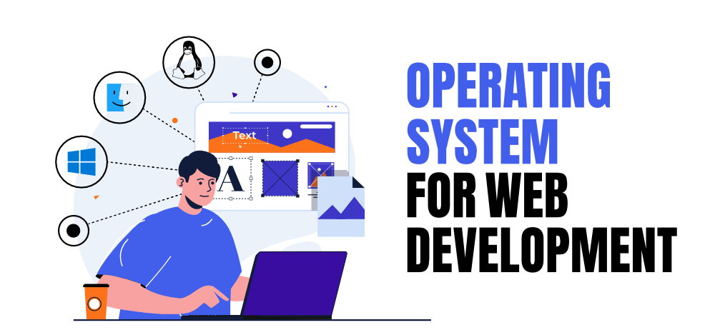
EXAMPLES OF WEB BASED OPERATING SYSTEM
The 8 best Examples of Web-Based Operating Systems Software are:
Ubuntu
Parrot OS
Netrunner
Oracle Linux
Talos Os
Praxie
Copperhead OS
Jide OS

Slide 7

Why Web-based applications are important?
Web-based applications are Important because they are:
Easier to develop using python language
It is more useful for users
Easier to install, maintain, and keep secure
Easier to grow as your company grows in business field

Slide 8
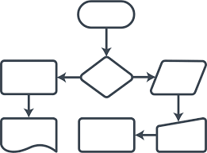
FLOWCHART
Start
User made a request to run a program with some data
It then checks whether local system can meet quality of service parameters or not
The request is then passed on to closest educative engine
The engine might reject request or pass it on to other educative engines
The engine then performs a search in its resources
End

Slide 9

What is Ubuntu?
Ubuntu is a Linux distribution Software. It is an operating system for your PC.
It is free, both as in speech and as in beer.
Anyone can modify and improve Ubuntu, similar to wikipedia.
Only Microsoft can change Windows, so when a flaw is discovered, it can go a long time unsolved.

Slide 10
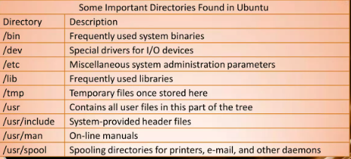
Important directories used in Ubuntu

Slide 11

Why we use ubuntu?
Developers can find the features of Ubuntu operating system for stability, continuous updates, and security. Canonical provides Long-Term Support releases of Ubuntu at an interval of five years. Developers can find security updates, hardware support, and critical bug fixes in these long-term support releases.

Slide 12
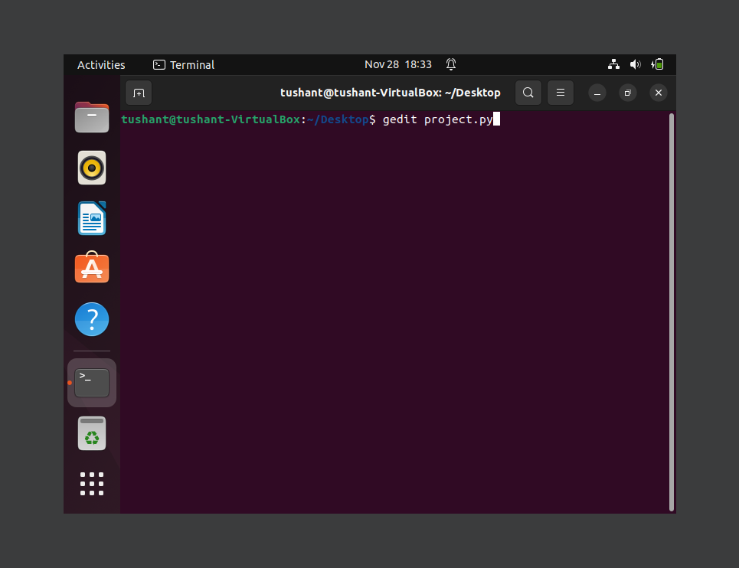
IMPLEMENTATION
Why we use gedit?
Gedit allows you to add new features to itself as it is a flexible plugin system. Most Linux users use tools like nano and vim to edit the configuration page. But the gedit editor will make your work more manageable if you wish to edit a file graphically. In your Ubuntu system,

Slide 13
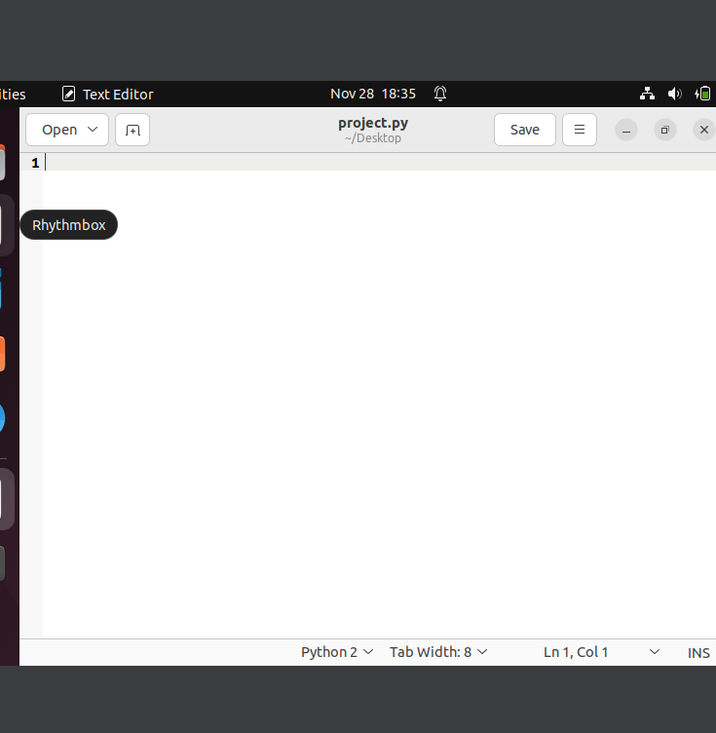
The text editor will open when we write gedit in which we have to implement the code
In text editor we can write code in many languages like C , C++ , Java , Python etc.
In our project we used Python Language that’s why we wrote .py for coding.

Slide 14
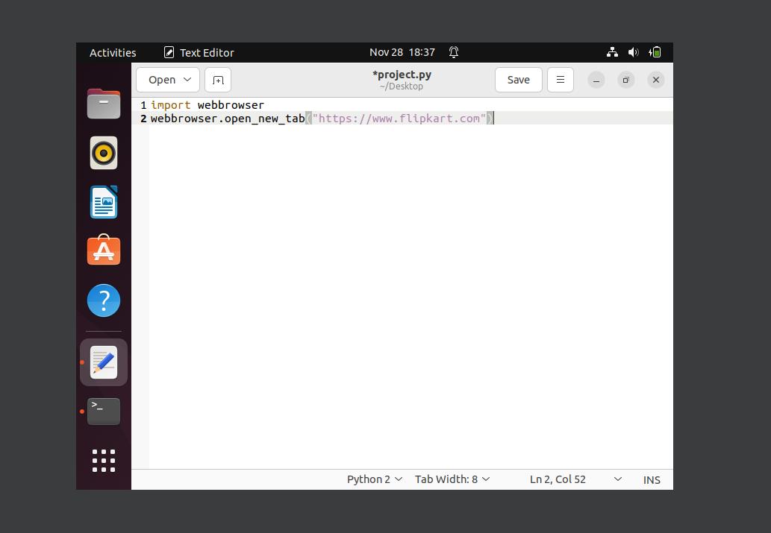
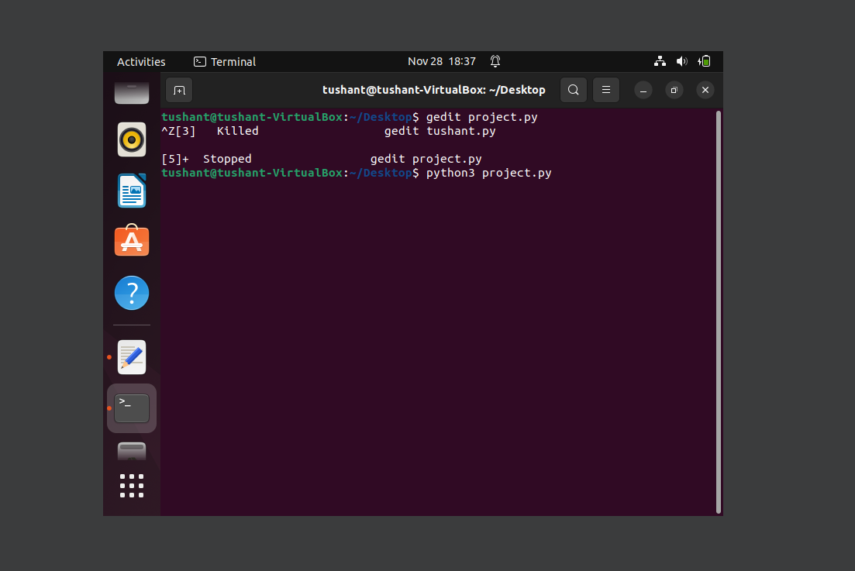
Webbrowser module is a convenient web browser controller. It provides a high-level interface that allows displaying Web-based documents to users
To run the program we write python3 project.py and enter it

Slide 15
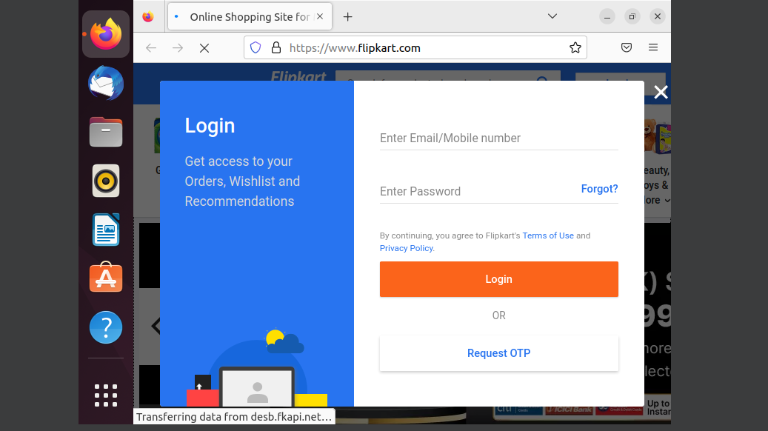
PROJECT RESULT

Slide 16



Contribution in PPT
TUSHANT KARIHALOO
CONTRIBUTION:
Information about webOS and Implementation
MADHAV SHARMA
CONTRIBUTION:
Importance ,example and flowchart
GAURANG MANTOO
CONTRIBUTION:
About Ubuntu,Important directories of Ubuntu
PPT Made by- Tushant Karihaloo

Slide 17
THANK YOU

